Slide 1

3.4 Token Recognition (P.98)
How can we use concepts developed so far to assist in recognizing tokens of a source language ?
Assume Following Tokens:
if, then, else, relop, id, num
What language construct are they used for ?
Given Tokens, What are Patterns ?
Example 3.6 Grammar:
stmt → |if expr then stmt
|if expr then stmt else stmt
|∈
expr → term relop term | term
term → id | num
if → if
then → then
else → else
relop → < | <= | > | >= | = | <>
id → letter ( letter | digit )*
num → digit ⁺ (. digit ⁺ ) ? ( E(+ | -) ? digit ⁺ ) ?
What does this represent ? What is Σ ?

Slide 2
What Else Does Lexical Analyzer Do? (P.99)
Scan away b, nl, tabs
Can we Define Tokens For These?
Character Escape Sequence
" \“
' \‘
? \?
\ \\
BEL \a
BS \b
FF \f
NL \n
CR \r
HT \t
VT \v
blank → b
tab → ^T
newline → ^M
delim → blank| tab | newline
ws → delim ⁺ (ws is whitespace)

Slide 3
Regular Expression
Token
Attribute-Value
Note:
Each token has a unique token identifier to define category of lexemes
ws
if
then
else
id
num
<
<=
=
< >
>
>=
-
if
then
else
id
num
relop
relop
relop
relop
relop
relop
-
-
-
-
pointer to table entry
pointer to table entry
LT
LE
EQ
NE
GT
GE
value
Fig.3.10 Regular-expression patterns for tokens. (P.99)

Slide 4
Constructing Transition Diagrams for Tokens (P.99)
Transition Diagrams (TD) are used to represent the tokens
As characters are read, the relevant TDs are used to attempt to match lexeme to a pattern
Each TD has:
  States : Represented by Circles
  Actions : Represented by Arrows between states
  Start State : Beginning of a pattern (Arrowhead)
  Final State(s) : End of pattern (Concentric Circles)
Each TD is Deterministic - No need to choose between 2 different actions !
Notes:
Concentric: 同中心的

Slide 5
Example TDs (P.100)
> = :
start
>
=
RTN(GE)
0
6
7
other
*
RTN(G)
8
* means: We’ve accepted “>” and have read other char that must be unread.
Fig.3.11 Transition diagram for >=.

Slide 6
Example 3.7: All RELOPs (P.101)
start
<
=
0
1
2
return(relop, LE)
>
3
return(relop, NE)
other
*
=
4
return(relop, LT)
5
return(relop, EQ)
>
=
6
7
return(relop, GE)
other
*
8
return(relop, GT)
Fig.3.12 Transition diagram for relational operators.

Slide 7
Example 3.8, 3.10 : id and delim (P.101)
delim :
delim
start
delim
other
*
28
29
30
id :
letter or digit
start
letter
other
*
9
10
11
return( get_token(), install_id())
Either returns ptr or “0” if reserved
Fig.3.13 Transition diagram identifiers and keywords.

Slide 8
When a token is recognized, one of the following must be done:
  If keywords: return 0
  If ID in symbol table: return entry of symbol table
  If ID not in symbol table: install id and return the new entry of symbol table
Placing keywords in the symbol table is almost essential and is coded by hand, or placing keywords in other table called keywords/reserved-words table.
How to describe level ?

Slide 9
Example 3.9 : Unsigned #s (P.102)
digit
digit
digit
start
digit
.
digit
E
+ | -
digit
other
*
12
13
14
15
16
17
18
19
E
digit
digit
digit
start
digit
*
.
digit
other
*
20
21
22
23
24
return(num, install_num())
digit
start
digit
other
*
25
26
27
The lexeme for a given token must be the longest possible. “greed”
Questions: Is ordering important for unsigned #s ?
Why are there no TDs for then, else, if ? (the same as id)
Fig.3.14 Transition diagram for unsigned numbers in Pascal.

Slide 10
QUESTION :
What would the transition diagram (TD) for strings containing each vowel, in their strict lexicographical order, look like ?

Slide 11
Answer
cons → B | C | D | F | … | Z
string → cons* A cons* E cons* I cons* O cons* U cons*
cons
cons
cons
cons
cons
cons
start
A
E
I
O
U
other
accept
Note: The error path is taken if the character is other than a cons or the vowel in the lex order.
error

Slide 12
What Else Does Lexical Analyzer Do? (P.102)
All Keywords / Reserved words are matched as ids
After the match, the symbol table or a special keyword table is consulted
Keyword table contains string versions of all keywords and associated token values
if
257
then
258
begin
259
...
...
When a match is found, the token is returned, along with its symbolic value, i.e., “then”, 258
If a match is not found, then it is assumed that an id has been discovered
Notes:
关于单词（token）的值的说明：
词法分析程序返回的是一个整型值，这个值就叫作token number。在GCC编译程序中，token
number 是经过c语言的宏定义命令来实现将其与对应的符号一一对应，词法分析程序才能够以返回这些符号来实现把这些数字返回给语法分析程序。例如：
＃define IDENTIFIER 257
这样在词法分析程序中就可用IDENTIFIER来作为返回值代替257，有利于程序代码的可读性。
在YACC中对词法分析单词(token)的返回值有如下的规定：
1、对字符集的字符，其默认的token number就是它的ASCII码的值，范围是0－255；
2、其他名字的token number 从257开始分配。YACC定义了53个单词的名字，这些名字的定义在c-parse.y文件中。

Slide 13
Implementing Transition Diagrams (P.104)
FUNCTIONS USED
nextchar(), forward(), retract(),
install_num(), install_id(), gettoken(), isdigit(), isletter(), recover()
lexeme_beginning = forward;
state = 0;
token nexttoken()
{ while(1) {
switch (state) {
case 0: c = nextchar();
/* c is lookahead character */
if (c== blank || c==tab || c== newline) {
state = 0;
lexeme_beginning++;
/* advance
beginning of lexeme */
}
else if (c == ‘<‘) state = 1;
else if (c == ‘=‘) state = 5;
else if (c == ‘>’) state = 6;
else state = fail();
break;
… /* cases 1-8 here */
repeat
until
a “return”
occurs
start
0
<
1
=
2
>
3
other
=
4
*
5
>
6
=
7
other
*
8

Slide 14
Implementing Transition Diagrams, II
digit
*
digit
other
25
26
27
advances
forward
.............
case 25; c = nextchar();
if (isdigit(c)) state = 26;
else state = fail();
break;
case 26; c = nextchar();
if (isdigit(c)) state = 26;
else state = 27;
break;
case 27; retract(1); lexical_value = install_num();
return ( NUM );
.............
Case numbers correspond to transition diagram states !
looks at the region
lexeme_beginning ... forward
retracts
forward

Slide 15
Implementing Transition Diagrams, III
.............
case 9: c = nextchar();
if (isletter(c)) state = 10;
else state = fail();
break;
case 10; c = nextchar();
if (isletter(c)) state = 10;
else if (isdigit(c)) state = 10;
else state = 11;
break;
case 11; retract(1); lexical_value = install_id();
return ( gettoken(lexical_value) );
.............
letter or digit
*
letter
other
reads token
name from ST
9
10
11
Fig.3.16 C code for lexical analyzer. (P.106)

Slide 16
When Failures Occur: (P.105)
Init fail()
{ start = state;
forward = lexeme beginning;
switch (start) {
case 0: start = 9; break;
case 9: start = 12; break;
case 12: start = 20; break;
case 20: start = 25; break;
case 25: recover(); break;
default: /* lex error */
}
return start;
}
Switch to
next transition
diagram
Fig.3.15 C code to find next start state.

Slide 17
3.6 Finite Automata (P.113)
A recognizer for a language is a program that takes a string x, and answers “yes” if x is a sentence of that language, and “no” otherwise.
We call the recognizer of the tokens as a finite automaton.
A finite automaton can be: deterministic(DFA) or non-deterministic (NFA)
This means that we may use a deterministic or non-deterministic automaton as a lexical analyzer.

Slide 18
Finite Automata (cont.)
Finite Automata :
A recognizer that takes an input string & determines whether it’s a valid sentence of the language
Non-Deterministic :
Has more than one alternative action for the same input symbol.
Deterministic :
Has at most one action for a given input symbol.
Both types are used to recognize regular expressions.

Slide 19
Finite Automata (cont.)
Both deterministic and non-deterministic finite automaton recognize regular sets.
Which one?
  deterministic – faster recognizer, but it may take more space
  non-deterministic – slower, but it may take less space
  Deterministic automatons are widely used lexical analyzers.
First, we define regular expressions for tokens; Then we convert them into a DFA to get a lexical analyzer for our tokens.
  Algorithm1: Regular Expression ➔ NFA ➔ DFA (two steps: first to NFA, then to DFA)
  Algorithm2: Regular Expression ➔ DFA (directly convert a regular expression into a DFA)

Slide 20
NFAs & DFAs
Non-Deterministic Finite Automata (NFAs) easily represent regular expression, but are somewhat less precise.
Deterministic Finite Automata (DFAs) require more complexity to represent regular expressions, but offer more precision.
We’ll review both plus conversion algorithms, i.e.,
NFA → DFA and DFA → NFA

Slide 21
A strong relationship between finite automata and regular expression
Transition: record a change from one state to another upon a match of the character or characters by which they are labeled.
start state: the recognition process begins
drawing an unlabeled arrowed line to it coming “from nowhere”
accepting states: represent the end of the recognition process.
drawing a double-line border around the state in the diagram
EX.: Identifier ->letter (letter | digit)*
letter
1
letter
2
digit

Slide 22
Non-Deterministic Finite Automata (P.114)
An NFA is a mathematical model that consists of :
  S, a set of states
  Σ, the symbols of the input alphabet
  move, a transition function.
    move(state, symbol) → set of states
    move : S × Σ∪{∈} → Pow(S) (path of word)
  A state, s₀ ∈ S, the start state
  F ⊆ S, a set of final or accepting states.

Slide 23
NFA (cont.)
ε- transitions are allowed in NFAs. In other words, we can move from one state to another one without consuming any symbol.
A NFA accepts a string x, if and only if there is a path from the starting state to one of accepting states such that edge labels along this path spell out x.

Slide 24
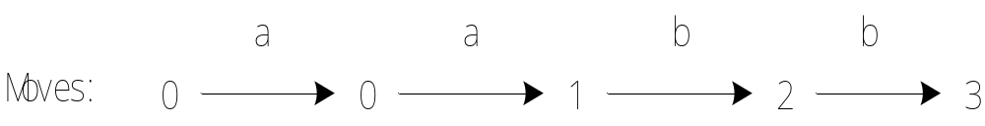
EX. Regular expression: (a|b)*abb
a
start
0
a
1
b
2
b
3
b
The moves of string “aabb”:

Slide 25
Representing NFAs
Transition Diagrams :
Transition Tables:
Number states (circles), arcs, final states, …
More suitable to representation within a computer
We’ll see examples of both !

Slide 26
Example NFA (P.114)
(a|b)*abb
a
S = { 0, 1, 2, 3 }
s₀ = 0
F = { 3 }
Σ = { a, b }
start
0
a
1
b
2
b
3
b
What Language is defined ?
Fig.3.19. Transition graph of the NFA
What is the Transition Table ?
i n p u t
state
∈ (null) moves possible
a
b
Fig.3.20. Transition table for the finite automaton of Fig.3.19.
∈
0
{ 0, 1 }
{ 0 }
i
j
1
--
{ 2 }
Switch state but do not use any input symbol
2
--
{ 3 }

Slide 27
NFA (exercise)
The language recognized by this NFA is (a|b) * a b, figure out the transition graph and transition table for NFA.

Slide 28
NFA (exercise answer)
0 is the start state s₀
{2} is the set of final states F
= {a,b}
S = {0,1,2}
Transition Function:
a b
0 {0,1} {0}
1 _ {2}
2 _ _
a
a
b
0
1
2
start
b
Fig.3.19. Transition graph of the NFA
Fig.3.20. Transition table for the finite automaton of Fig.3.19.
The language recognized by this NFA is (a|b) * a b

Slide 29
Another NFA exercise
The language recognized by this NFA is a (a|b) * b, figure out the transition graph and transition table for NFA.

Slide 30
How Does An NFA Work ?
a
start
0
a
1
b
2
b
3
b
Given an input string, we trace moves
If no more input & in final state, ACCEPT
EXAMPLE: Input: ababb
-OR-
move(0, a) = 0
move(0, b) = 0
move(0, a) = 1
move(1, b) = 2
move(2, b) = 3
ACCEPT !
move(0, a) = 1
move(1, b) = 2
move(2, a) = ? (undefined)
REJECT !

Slide 31
Handling Undefined Transitions
We can handle undefined transitions by defining one more state, a “death” state, and transitioning all previously undefined transition to this death state.
a
start
0
a
1
b
2
b
3
b
a
a
a, b
4
Σ

Slide 32
NFA- Regular Expressions & Compilation
Problems with NFAs for Regular Expressions:
1. Valid input might not be accepted
2. NFA may behave differently on the same input
Relationship of NFAs to Compilation:
1. Regular expression “recognized” by NFA
2. Regular expression is “pattern” for a “token”
3. Tokens are building blocks for lexical analysis
4. Lexical analyzer can be described by a collection of NFAs. Each NFA is for a language token.

Slide 33
Second NFA Example
Given the regular expression : (a (b*c)) | (a (b | c⁺)?)
Find a transition diagram NFA that recognizes it.

Slide 34
Second NFA Example - Solution
Given the regular expression : (a (b*c)) | (a (b | c⁺)?)
Find a transition diagram NFA that recognizes it.
(a (b*c)) | (a (b | c+)?)
b
c
a ((b*c) | (b | c+)?)
2
4
∈
∈
start
0
a
1
6
∈
∈
b
7
c
3
c
5
∈
String abbc can be accepted.

Slide 35
Alternative Solution Strategy
b
a
c
a (b*c)
1
2
3
∈
6
a (b | c+)?
4
a
5
b
c
c
Now that you have the individual diagrams, “or” them as follows:
7
∈

Slide 36
Using Null Transitions to “OR” NFAs
b
a
c
1
2
3
∈
0
∈
6
∈
4
a
5
b
c
c
7
∈

Slide 37
Other issues
Not all paths may result in acceptance.
a
start
0
a
1
b
2
b
3
b
aabb is accepted along path : 0 → 0 → 1 → 2 → 3
BUT… it is not accepted along the valid path:
0 → 0 → 0 → 0 → 0
DFA

Slide 38
Deterministic finite automation (DFA) (P.115)
A DFA is an NFA with the following restrictions:
  ∈ moves are not allowed
  For every state s ∈S, there is one and only one path from s for every input symbol a ∈ Σ.

Slide 39
Implementing a DFA (P.116)
Let us assume that the end of a string is marked with a special symbol (say eof). The algorithm for recognition will be as follows: (an efficient implementation) (algorithm 3.1 p116)
s ← s₀
c ← nextchar;
while c ≠ eof do
s ← move(s,c); //state transition
c ← nextchar; //read next character
end;
if s is in F then return “yes”
else return “no”
Cf. NFA
Fig.3.22 Simulating a DFA.

Slide 40
Implementing a NFA (P.126)
  S ⬅ ε-closure({s₀}) { set all of states can be accessible from s₀ by ε-transitions }
  c ⬅ nextchar
  while (c != eof) {
  begin
  s ⬅ ε-closure(move(S,c)) { set of all states can be accessible from a state in S
  c ⬅ nextchar by a transition on c }
  end
  if (S∩F != Φ) then { if S contains an accepting state }
  return “yes”
  else
  return “no”
This algorithm is not efficient.
Fig.3.31 simulating the NFA of algorithm 3.3 Thompson’s construction

Slide 41
DFA (example) (P.117)
(a|b) * a bb
Recall the original NFA:
a
start
0
a
1
b
2
b
3
b
What Language is Accepted?
b
a
start
0
a
1
b
2
b
3
a
b
a
Fig.3.23. DFA accepting (a|b) * abb

Slide 42
Converting a NFA into a DFA (P.117)
given an arbitrary NFA, construct an equivalent DFA (i.e., one that accepts precisely the same strings)
need:
1、eliminating ε-transitions
an ε-closure: the set of all states reachable by ε-transitions from a state or states.
2、multiple transitions from a state on a single input character.
keeping track of the set of states that are reachable by matching a single character.

Slide 43
Both these processes lead us to consider sets of states instead of single state. Thus, it is not surprising that the DFA we construct has as its states sets of states of the original NFA.
The algorithm is called the subset construction (子集构造法或子集法).

Slide 44
Conversion : NFA → DFA
Algorithm Constructs a Transition Table for DFA from NFA
Each state in DFA corresponds to a SET of states of the NFA
Why does this occur ?
  ∈ moves
  non-determinism
  Both require us to characterize multiple situations that occur for accepting the same string.
  (Recall : Same input can have multiple paths in NFA)
Key Issue : Reconciling AMBIGUITY !

Slide 45
Algorithm Concepts
operation | description
ε-closrue(s) | Set of NFA states reachable from NFA state s on ε-transitions alone.
ε-closrue(T) | Set of NFA states reachable from some NFA states in T on ε-transitions alone.
Move(T,a) | Set of NFA states to which there is a transition on input symbol a from some NFA state s in T.
Fig.3.24 Operations on NFA states. (P.118)

Slide 46
Algorithm Concepts （cont.）
NFA N = ( S, Σ, s₀, F, MOVE )
∈-Closure(s) : s ∈S
: set of states in S that are reachable
from s via ∈-moves of N that originate
from s.
∈-Closure(T) : T ⊆ S
: NFA states reachable from all t ∈ T
on ∈-moves only.
move(T,a) : T ⊆ S, a∈Σ
: Set of states to which there is a
transition on input a from some t ∈ T
No input is consumed
These 3 operations are utilized by algorithms / techniques to facilitate the conversion process.

Slide 47
Algorithm for subset construction (P.118)
  put ε-closure({s₀}) as an unmarked state into the set of DFA (DStates)
  while (there is one unmarked S₁ in DStates) do
  begin
  mark S₁
  for each input symbol a do
  begin
  S₂ ⬅ ε-closure(move(S₁,a))
  if (S₂ is not in DStates) then
  add S₂ into DStates as an unmarked state
  transfunc[S₁,a] ⬅ S₂
  end
  end
the start state of DFA is ε-closure({s₀})
a state S in DStates is an accepting state of DFA if a state in S is an accepting state of NFA
ε-closure({s₀}) is the set of all states can be accessible from s₀ by ε-transition.
set of states to which there is a transition on a from a state s in S₁
Fig.3.25. the subset construction

Slide 48
Algorithm For Subset Construction (cont.)(P.119)
push all states in T onto stack;
initialize ∈-closure(T) to T;
while stack is not empty do begin
pop t, the top element, off the stack;
for each state u with edge from t to u labeled ∈ do
if u is not in ∈-closure(T) do begin
add u to ∈-closure(T) ;
push u onto stack
end
end
computing the
∈-closure
Fig.3.26. computation of ∈-closure.

Slide 49
Converting NFA to DFA – 1st Look (Example3.15 P.119)
Start with NFA: (a | b)*abb
∈
a
2
3
∈
∈
start
∈
∈
a
b
b
0
1
6
7
8
9
10
∈
∈
b
4
5
∈
From State 0, Where can we move without consuming any input ?
This forms a new state: 0,1,2,4,7 What transitions are defined for this new state ?

Slide 50
Converting a NFA into a DFA (calculate ε-closure )
ε
2
a
3
ε
ε
0
ε
1
ε
a
b
b
ε
6
7
8
9
10
ε
4
b
5
Fig.3.27. NFA N for (a|b)*abb
ε
ε-closure({0}) = {0,1,2,4,7}=S0 S₀into DS as an unmarked state
⇓ mark S0
ε-closure(move(S0,a)) = ε-closure({3,8}) = {1,2,3,4,6,7,8} = S1 S1 into DS
ε-closure(move(S0,b)) = ε-closure({5}) = {1,2,4,5,6,7} = S2 S2 into DS
transfunc[S0,a] ⬅ S1 transfunc[S0,b] ⬅ S2
⇓ mark S1
ε-closure(move(S1,a)) = ε-closure({3,8}) = {1,2,3,4,6,7,8} = S1
ε-closure(move(S1,b)) = ε-closure({5,9}) = {1,2,4,5,6,7,9} = S3
transfunc[S1,a] ⬅S1 transfunc[S1,b] ⬅ S3
⇓ mark S2
ε-closure(move(S2,a)) = ε-closure({3,8}) = {1,2,3,4,6,7,8} = S1
ε-closure(move(S2,b)) = ε-closure({5}) = {1,2,4,5,6,7} =S2
transfunc[S2,a] ⬅ S1 transfunc[S2,b] ⬅ S2

Slide 51
2
a
3
ε
ε
0
ε
1
ε
a
b
b
ε
6
7
8
9
10
ε
4
b
5
ε
⇓ mark S3
ε-closure(move(S3,a)) = ε-closure({3,8}) = {1,2,3,4,6,7,8} = S1
ε-closure(move(S3,b)) = ε-closure({5,10}) = {1,2,4,5,6,7,10} = S4
transfunc[S3,a] ⬅ S1 transfunc[S3,b] ⬅ S4
⇓ mark S4
ε-closure(move(S4,a)) = ε-closure({3,8}) = {1,2,3,4,6,7,8} =S1
ε-closure(move(S4,b)) = ε-closure({5}) = {1,2,4,5,6,7} = S2
transfunc[S4,a] ⬅ S1 transfunc[S4,b] ⬅ S2

Slide 52
Conversion Example – continued (4)
This gives the transition table Dtran for the DFA of:
Input Symbol
Dstates
a
b
S0 S1 S2
S1 S1 S3
S2 S1 S2
S3 S1 S4
S4 S1 S2
Fig.3.28. transition table Dtran for DFA.

Slide 53
b
b
S2
b
a
start
S0
a
S1
b
S3
b
S4
a
a
a
Fig.3.29. result of applying the subset construction to Fig.3.27. (P.121)
Fig.3.29. vs. Fig.3.23. (P.117)

Slide 54
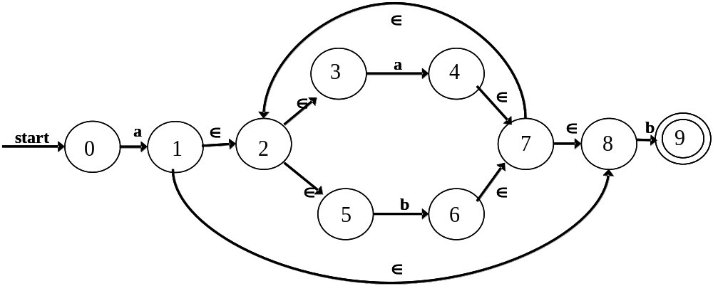
DFA (exercise in class)
The language recognized by this DFA is also a(a|b) *b, figure out a transition graph of DFA.

Slide 55
DFA (exercise answer)
Input Symbol
Dstates
a
b
S0 S1
S1 S1 S2
S2 S1 S2
a
start
a
b
0
1
2
a
b
DFA accepting a (a|b) * b

Slide 56
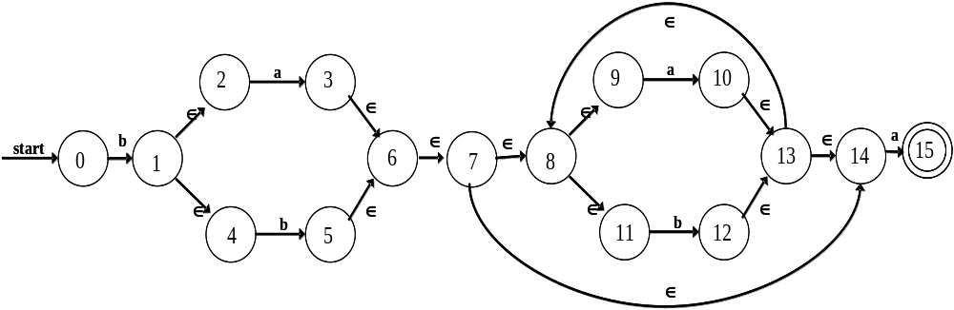
Another exercise
Using subset construction to construct DFA from NFA.
b(a|b)⁺a

